Slide 1

Hotel Reservation Website
Group 7: Le Hoang Ky
Nguyen Dang Quy
Nguyen Duy Long

Slide 2
Hotel Reservation Website
The reason for making the web
The Features of the web
Website development direction

Slide 3



The reason for making the web

Slide 4
The reason for making the web
Hotel Reservation Website
h
ttp://
ww
w
.googl
e
.
c
om/
The demand of tourists has increased in recent years.
Attracting tourists from many other places.
Can book at home without having to take place to book.
h
ttp://
ww
w
.googl
e
.
c
om/
h
ttp://
ww
w
.googl
e
.
c
om/

Slide 5
The Features of the web
Sign in and sign up
Analyze each type and price of the room
Room reservation feature

Slide 6
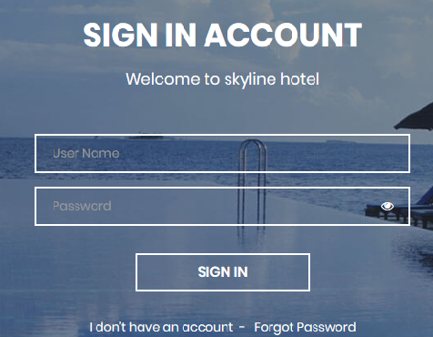
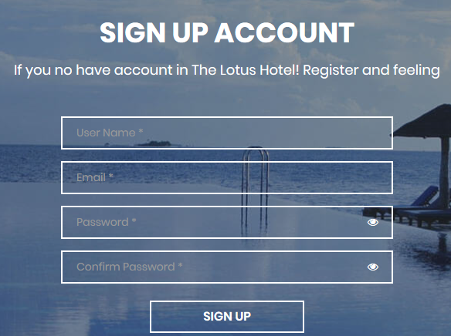
Sign in and Sign up
Hotel Reservation Website
h
ttp://
ww
w
.googl
e
.
c
h
om/
ttp://
ww
w
.googl
e
.
c
om/
Sign in
Sign up

Slide 7
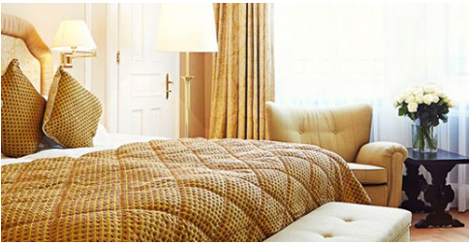
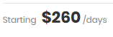
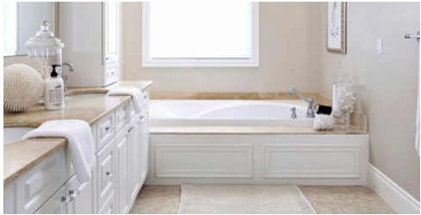
Analyze each type and price of the room
Hotel Reservation Website
Family Room: Bring the largest impressive and most advanced space in the room system.
Luxury Room: Located in the heart of Aspen with a unique blend of contemporary luxury and historic heritage.

Slide 8
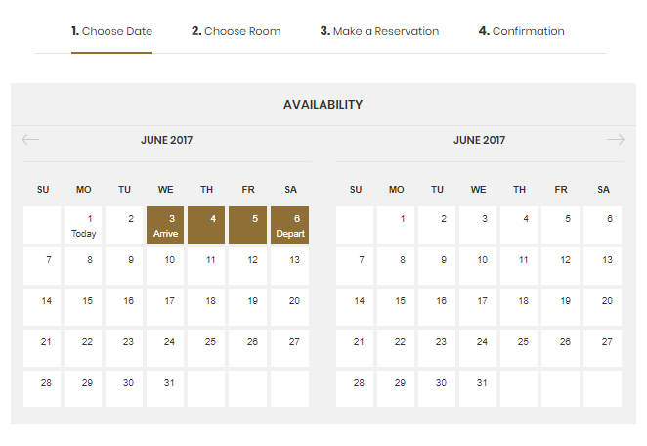
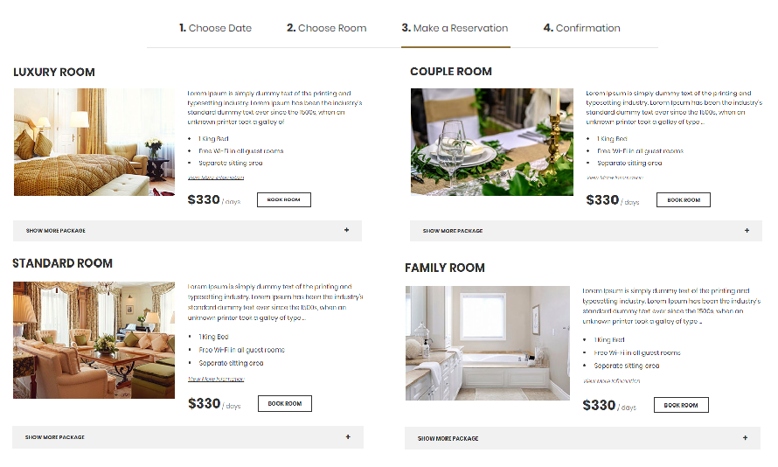

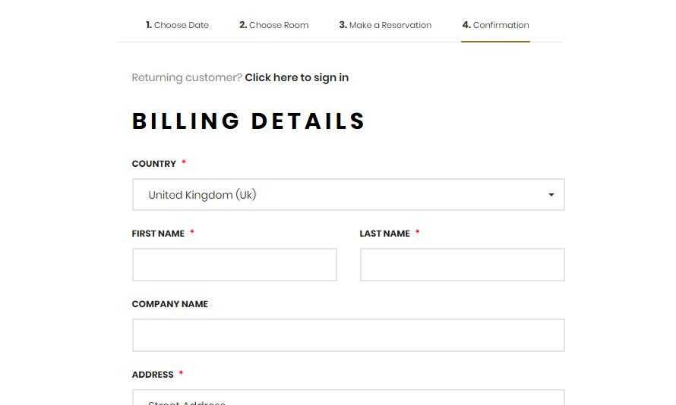
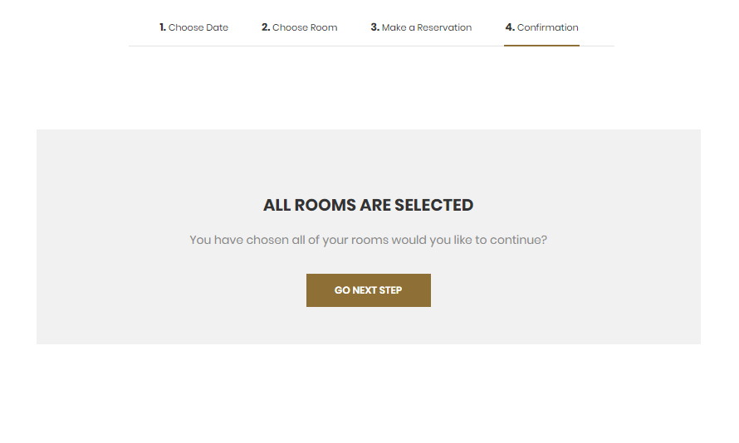
Room Reservation Feature
Hotel Reservation Website
h
ttp://
ww
w
.googl
e
.
c
om/
Instead of going to book, we have designed this online reservation feature so you can save your time
h
ttp://
ww
w
.googl
e
.
c
om/
h
ttp://
ww
w
.googl
e
.
c
om/
1. Choose Date
3. Make a Reservation
4. Confirmation
2. Choose Room

Slide 9
Website development direction

Slide 10
Website development direction
We must always keep our information up to date.
Each year, the website design will be changed to match trends and to compete with other websites.
In the future, we will have many new features and new approaches.

Slide 11



Poster

Slide 12
Thank You!

